Slide 1
TO-DO LIST
SUBMITTED TO:
Mr. Tushar Tkhitoliya
SUBMITTED BY :
Kashish Barthwal
2210990495
G-10

Slide 2
TABLE OF CONTENTS:
INTRODUCTION
PROBLEM STATEMENT
TECHNICAL DETAILS
KEY FEATURES
PROJECT HIGHLIGHTS
CONCLUSIONS
REFERENCES

Slide 3
INTRODUCTION:
The task manager application is designed to assist users in organizing their daily tasks efficiently.
With the increasing complexity of daily schedules, there arises a need for a reliable and user-friendly task management solution.
This application aims to streamline the process of task management, helping users stay organized and focused on their priorities.

Slide 4
OVERVIEW:
The Task Manager Application is a Python-based software solution aimed at simplifying task organization and enhancing productivity.
Key features include task addition and deletion functionalities, a user-friendly interface, and customization options for enhanced usability.
Developed using Python programming language and Tkinter library for GUI development, ensuring reliability and responsiveness.
Tasks are managed efficiently using Python's built-in data structures, facilitating seamless data handling and retrieval.

Slide 5
PROBLEM STATEMENT:
Many individuals struggle to keep track of their tasks effectively, leading to missed deadlines and increased stress levels.
Existing task management solutions may be overly complicated or lack essential features, making them unsuitable for users' needs.
The task manager application addresses these issues by providing a simple yet powerful platform for managing tasks effortlessly.

Slide 6
TECHNICAL DETAILS:
The application is developed using Python programming language.
Tkinter library is utilized for creating the graphical user interface (GUI), offering a seamless user experience.
Tasks are stored and managed using data structures provided by Python, ensuring efficient data handling and retrieval.

Slide 7
KEY FEATURES:
Task Addition: Users can easily add new tasks to the list through the intuitive interface.
Task Deletion: Unwanted tasks can be removed with a single click, keeping the task list clutter-free.
User-Friendly Interface: The GUI is designed to be simple and intuitive, allowing users to navigate the application with ease.

Slide 8
PROJECT HIGHLIGHTS:
The application offers a seamless task management experience, helping users prioritize and organize their tasks effectively.
User feedback has been positive, highlighting the simplicity and effectiveness of the application in enhancing productivity.
Continuous updates and improvements are planned to further enhance the functionality and usability of the application.

Slide 9
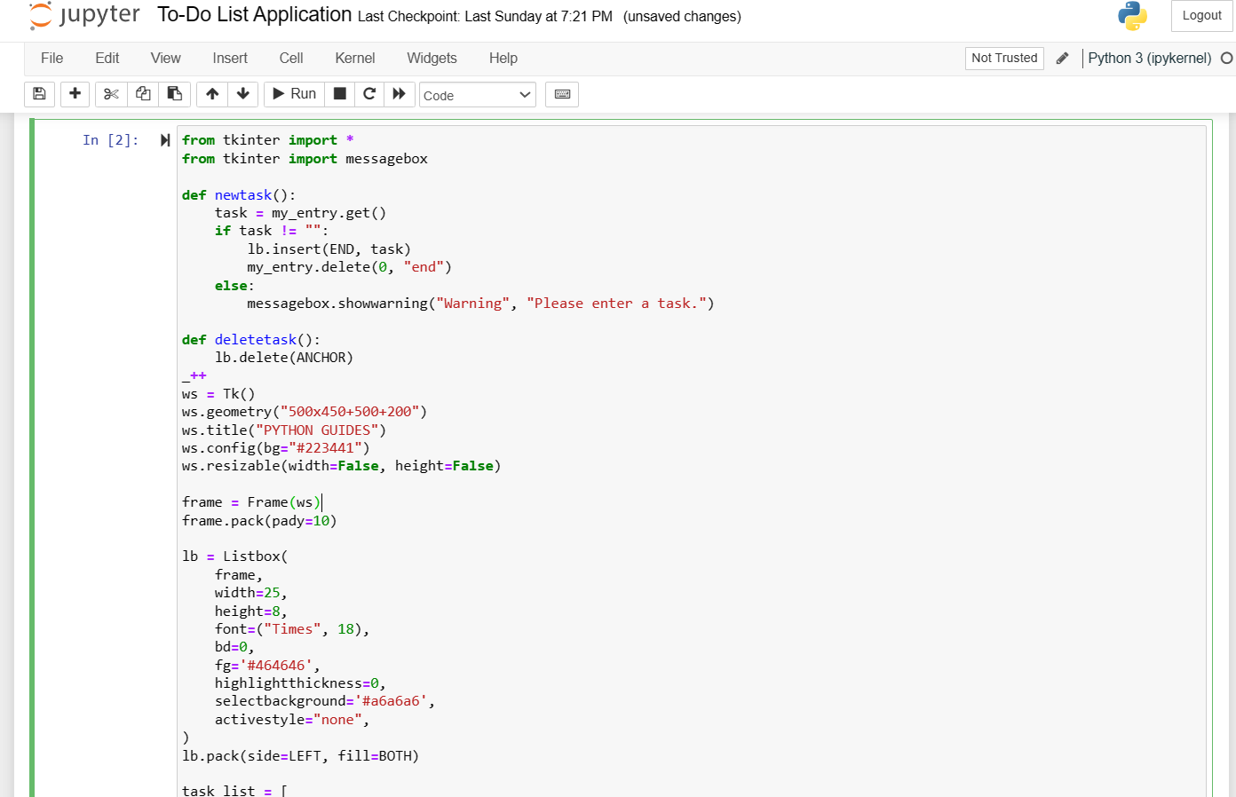
OUR CODE:

Slide 10
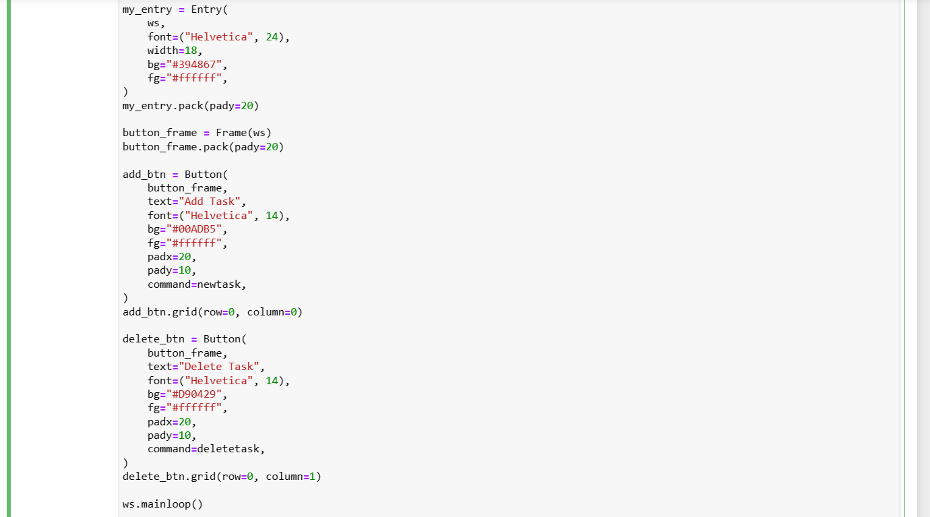

Slide 11
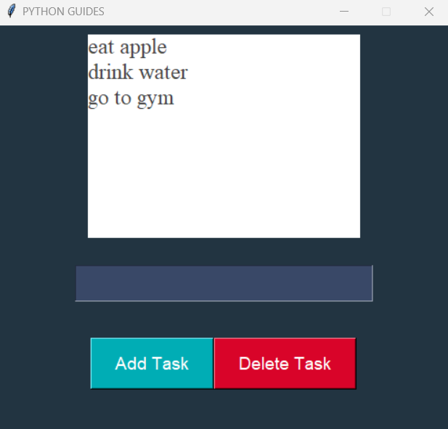
OUTPUT OF OUR CODE:

Slide 12
CONCLUSION:
In conclusion, the task manager application represents a significant step towards addressing the challenges of task management in today's fast-paced world.
By providing a simple yet powerful solution, the application empowers users to take control of their schedules and accomplish tasks more efficiently.
Looking ahead, the project team remains committed to enhancing the application and exploring new opportunities for innovation in task management.

Slide 13
REFERENCES:
Python Documentation: https://www.python.org/doc/
Tkinter Documentation: https://docs.python.org/3/library/tkinter.html
Stack Overflow: https://stackoverflow.com/
Tutorialspoint: https://www.tutorialspoint.com/python/index.htm

Slide 14


